Slide 1
Conventional Computing vs. Cloud Computing
Cloud
Conventional
Manually Provisioned
Dedicated Hardware
Fixed Capacity
Pay for Capacity
Capital & Operational Expenses
Self-provisioned
Shared Hardware
Elastic Capacity
Pay for Use
Operational Expenses

Slide 2
Cloud Computing Characteristics
Common Characteristics:
Massive Scale
Resilient Computing
Homogeneity
Geographic Distribution
Virtualization
Service Orientation
Low Cost Software
Advanced Security
Essential Characteristics:
On Demand Self-Service
Broad Network Access
Scalable and Elastic
Shared/Pool Resources
Metered by Use
Adopted from: Effectively and Securely Using the Cloud Computing Paradigm by peter Mell, Tim Grance
Notes:
ScalabilityInfrastructure capacity allows for traffic spikes and minimizes delays.
ResiliencyCloud providers have mirrored solutions to minimize downtime in the event of a disaster. This type of resiliency can give businesses the sustainability they need during unanticipated events.
Homogeneity: No matter which cloud provider and architecture an organization uses, an open cloud will make it easy for them to work with other groups, even if those other groups choose different providers and architectures.
On-demand self-service. A consumer can unilaterally provision computing capabilities, such as server time and network storage, as needed automatically without requiring human interaction with each service’s provider.
Broad network access. Capabilities are available over the network and accessed through standard mechanisms that promote use by heterogeneous thin or thick client platforms (e.g., mobile phones, laptops, and PDAs).
Resource pooling. Multi-tenant model.. There is a sense of location independence in that the customer generally has no control or knowledge over the exact location of the provided resources but may be able to specify location at a higher level of abstraction (e.g., country, state, or datacenter). Examples of resources include storage, processing, memory, network bandwidth, and virtual machines.
Rapid elasticity. Capabilities can be rapidly and elastically provisioned, in some cases automatically, to quickly scale out and rapidly released to quickly scale in. To the consumer, the capabilities available for provisioning often appear to be unlimited and can be purchased in any quantity at any time.
Measured Service. Cloud systems automatically control and optimize resource use by leveraging a metering capability at some level of abstraction appropriate to the type of service (e.g., storage, processing, bandwidth, and active user accounts).

Slide 3
Advantages and Disadvantages: Cloud Summary
Advantages
Lower computer cost
Improved performance
Reduced software cost
Instant software update
Improved doc. Format compatibility
Unlimited capacity
Increased data reliability
Universal doc. Access
Version control and availability
Easy group collaboration
Portability, device independence
Disadvantages
Requires const. internet connection
Bad performance with low speed connection
Limited features
Security and data loss issues

Slide 4
Elastic Computing
Elastic computing is the ability to quickly expand or decrease computer processing, memory and storage resources to meet changing demands without worrying about capacity planning and engineering for peak usage. Typically controlled by system monitoring tools, elastic computing matches the amount of resources allocated to the amount of resources actually needed without disrupting operations. With cloud elasticity, a company avoids paying for unused capacity or idle resources and does not have to worry about investing in the purchase or maintenance of additional resources and equipment.
.

Slide 5
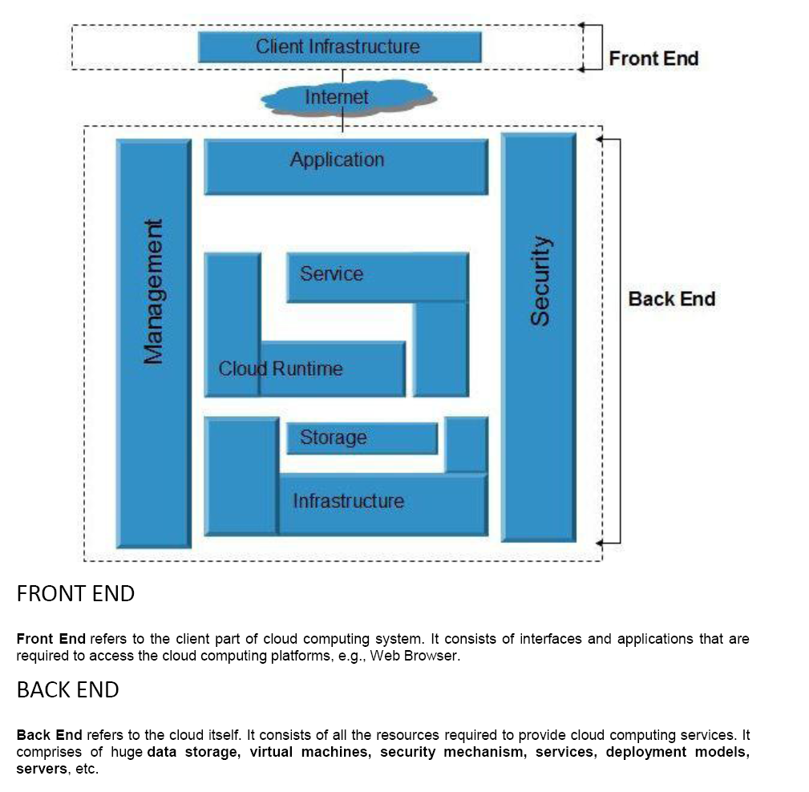
Cloud Computing Reference Architecture

Slide 6
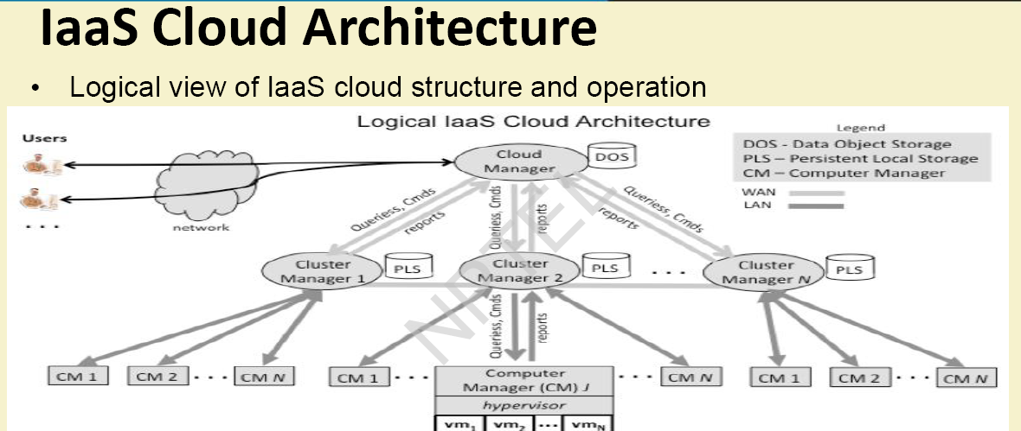

Slide 7
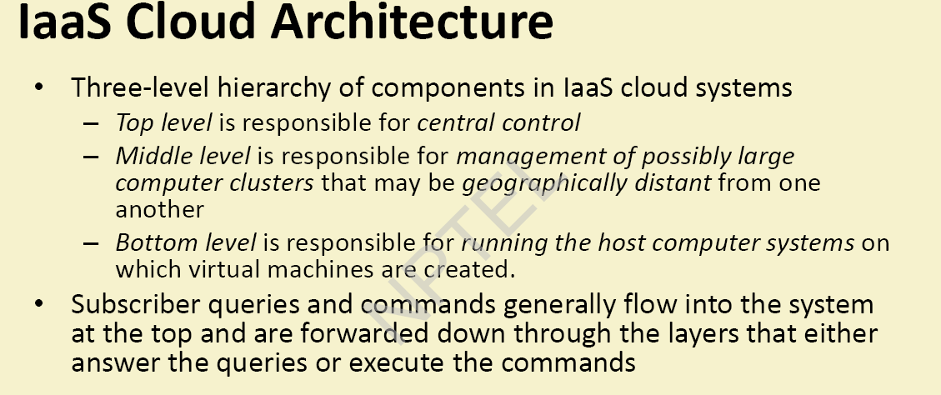

Slide 8
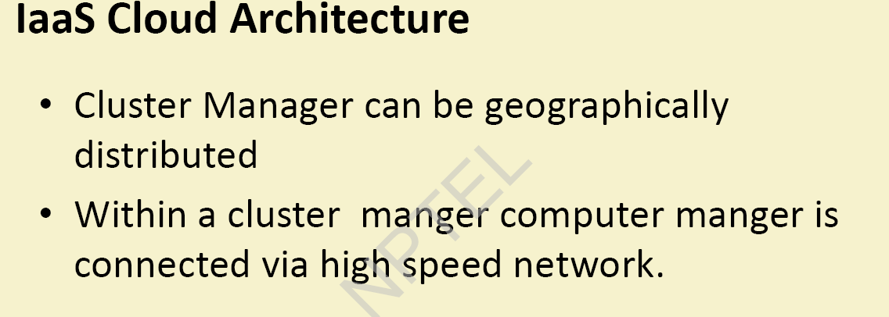

Slide 9
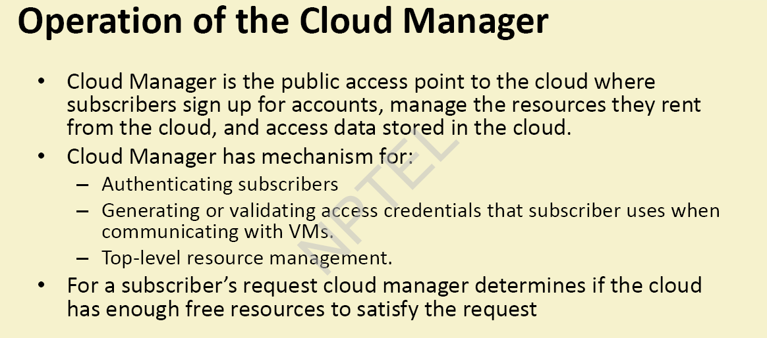

Slide 10
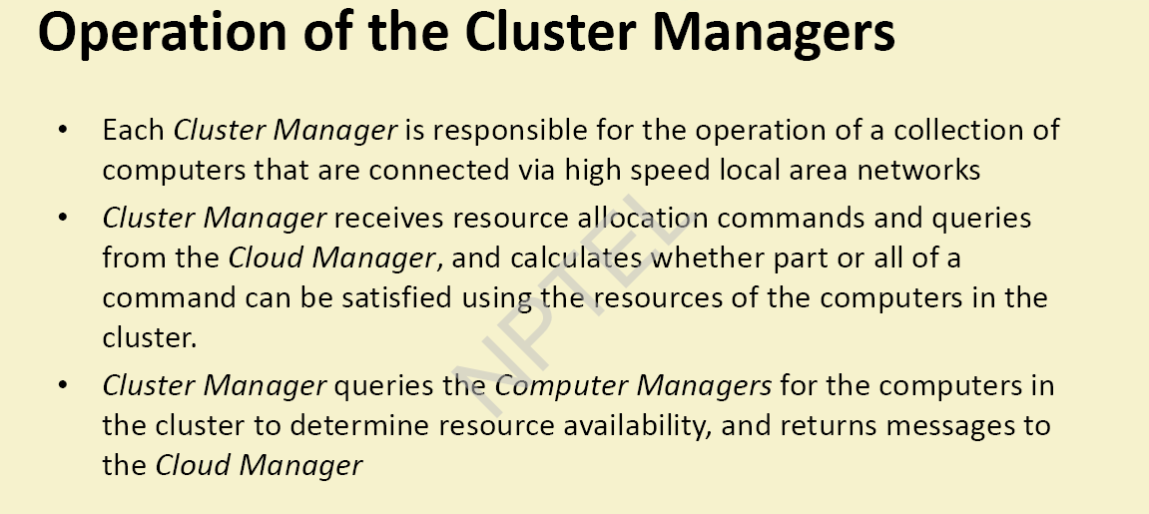

Slide 11
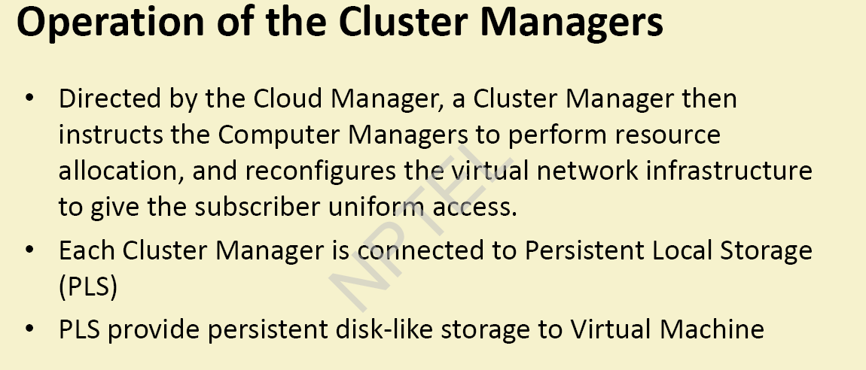

Slide 12
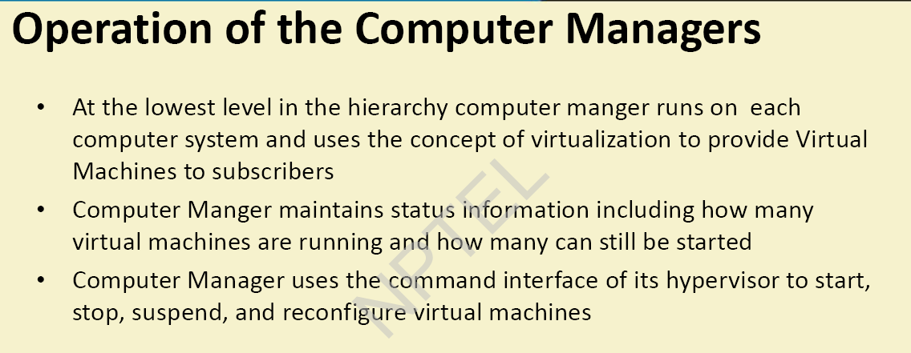

Slide 13
XaaS
Combination of Service-Oriented Infrastructure (SOI) and cloud computing realizes to XaaS.
X as a Service (XaaS) is a generalization for cloud-related services
XaaS stands for "anything as a service" or "everything as a service“
XaaS refers to an increasing number of services that are delivered over the Internet rather than provided locally or on-site
XaaS is the essence of cloud computing.

Slide 14
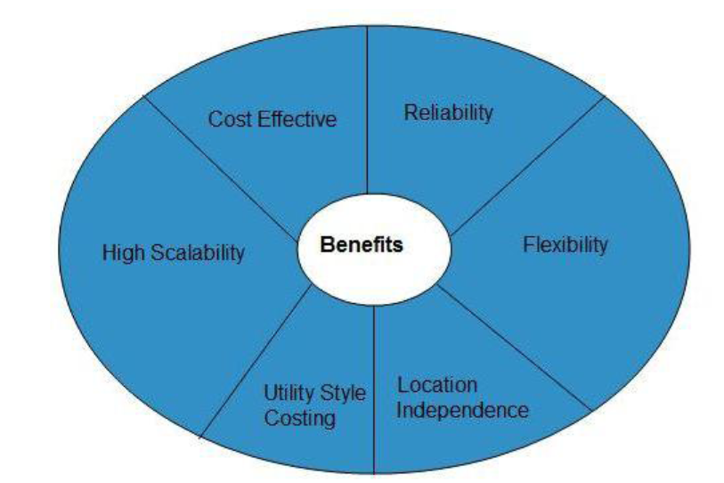
Benefits of Public Cloud Model

Slide 15
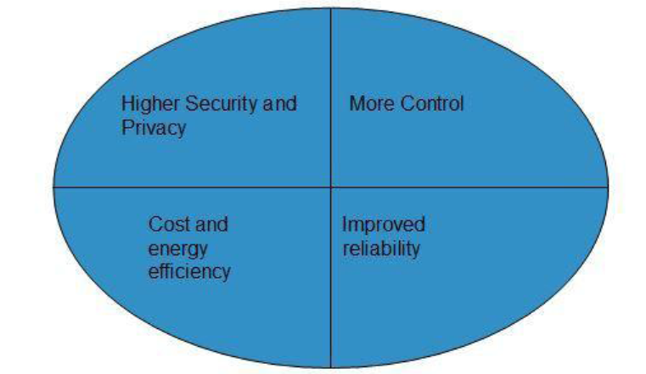
Benefits of Private Cloud

Slide 16
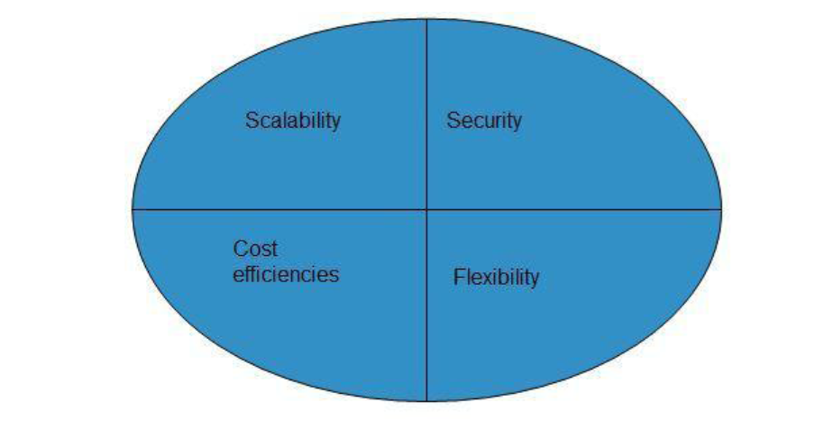
Benefits of Hybrid cloud Model

Slide 17
Disadvantage of Following Deployment Model
Public Cloud+ | Private Cloud | Hybrid Cloud
LOW SECURITY | RESTRICTED AREA | NETWORKING ISSUES
LESS CUSTOMIZABLE | LIMITED SCALABILITY | SECURITY COMPLIANCE

Slide 18
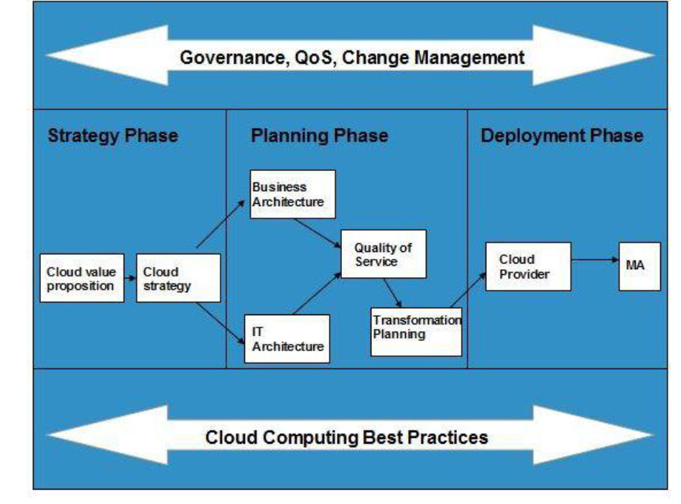
Cloud Computing Best Practice

Slide 19
Cloud Computing Planning
Following are the issues one must have to think about before opting Cloud Computing for organization:
Data Security and Privacy Requirement
Budget Requirements
Type of cloud - public, private or hybrid
Data backup requirements
Training requirements
Dashboard and reporting requirements
Client access requirements
Data export requirements
To meet all of these requirements, it is necessary to have well-compiled planning.

Slide 20
There are two steps to perform this analysis:
Cloud Computing Value Proposition
Cloud Computing Strategy Planning
CLOUD COMPUTING VALUE PROPOSITION
In this, we analyze the factors influencing the customers when applying cloud computing mode and target the key problems they wish to solve. These key factors are:
IT management simplification
operation and maintenance cost reduction
business mode innovation
low cost outsourcing hosting
high service quality outsourcing hosting.

Slide 21
MULTI-TENANCY
Multi-tenancy is an architectural pattern
A single instance of the software is run on the service provider’s infrastructure
Multiple tenants access the same instance.
In contrast to the multi-user model, multi-tenancy requires customizing the single instance according to the multi-faceted requirements of many tenants.

Slide 22
MULTI-TENANCY
A Multi-tenants application lets customers (tenants) share the same hardware resources, by offering them one shared application and database instance ,while allowing them to configure the application to fit there needs as if it runs on dedicated environment.
These definition focus on what we believe to be the key aspects of multi tenancy:
The ability of the application to share hardware resources.
The offering of a high degree of configurability of the software.
The architectural approach in which the tenants make use of a single application and database instance.

Slide 23
Multi-tenants Deployment Modes for Application Server
Fully isolated Application server Each tenant accesses an application server running on a dedicated servers.
Virtualized Application Server Each tenant accesses a dedicated application running on a separate virtual machine.
Shared Virtual Server Each tenant accesses a dedicated application server running on a shared virtual machine.
Shared Application Server The tenant shared the application server and access application resources through separate session or threads.
Application Server
Tenant A
Tenant B
Application server
Application server
Virtual machine
Tenant A
Virtual machine
Tenant B
Application server
Tenant A
Virtual machine
Tenant B
Session thread
Tenant A
Application Server
Tenant B
Session Thread

Slide 24
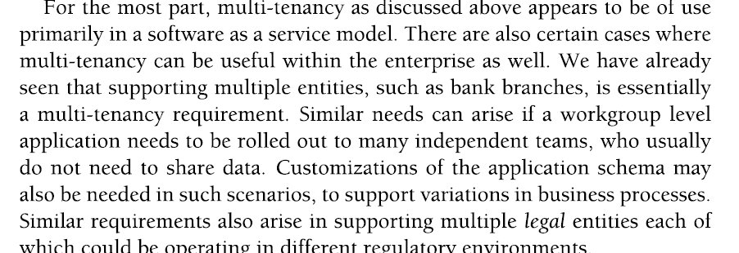
Muiti-tenancy Support

Slide 25
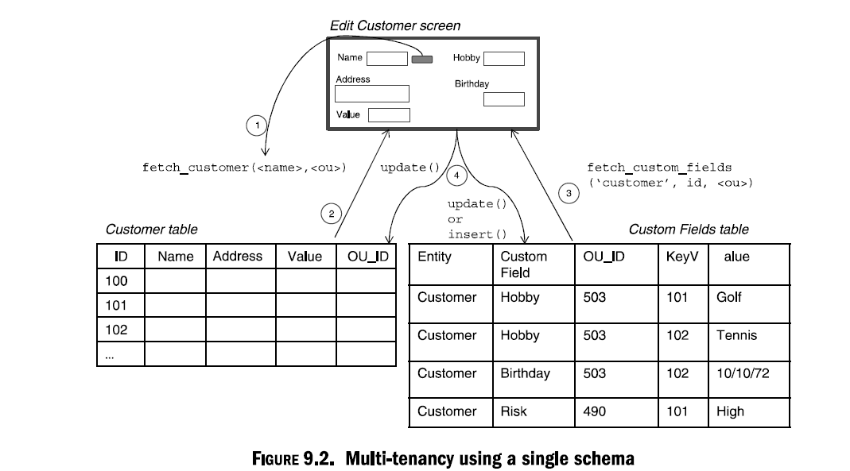
Multi-tenancy using single schema

Slide 26
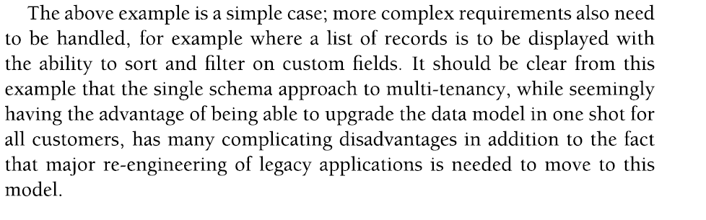
Multi-tenancy using single schema

Slide 27
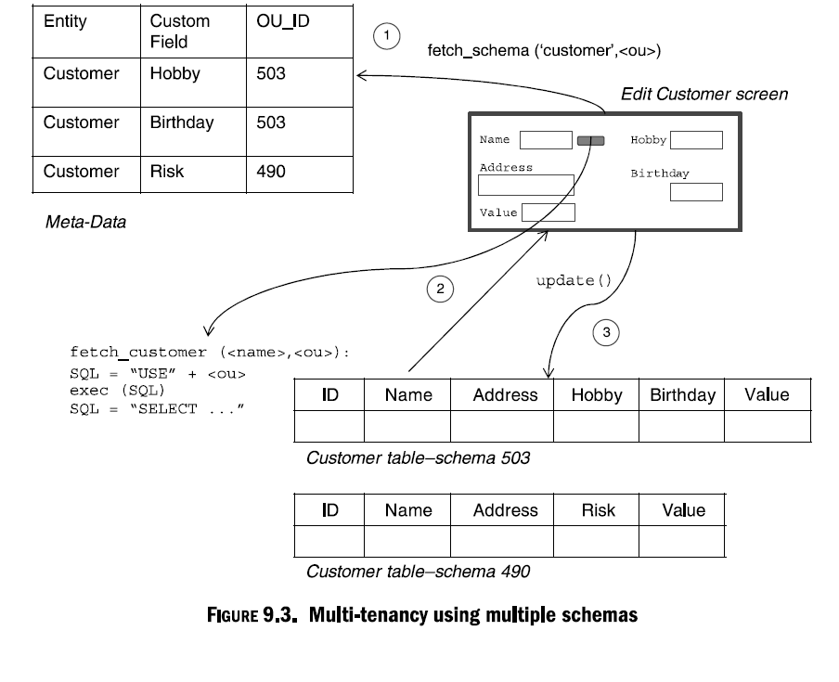
Multitenancy using Multiple Schema

Slide 28
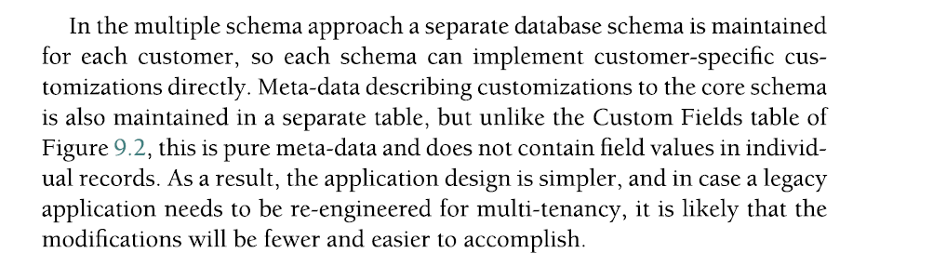
Multi-tenancy using Multiple Schema

